Slide 1
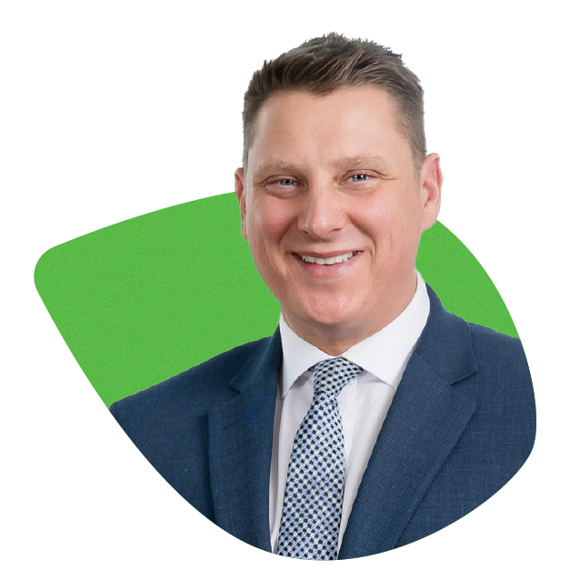
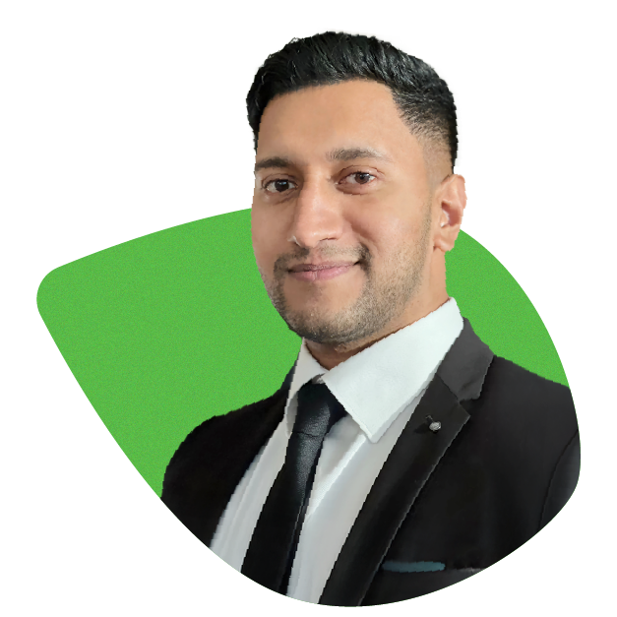

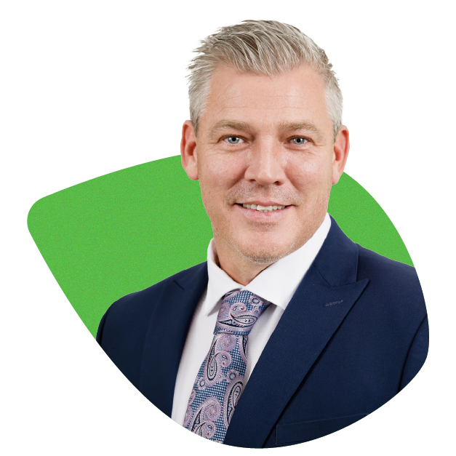
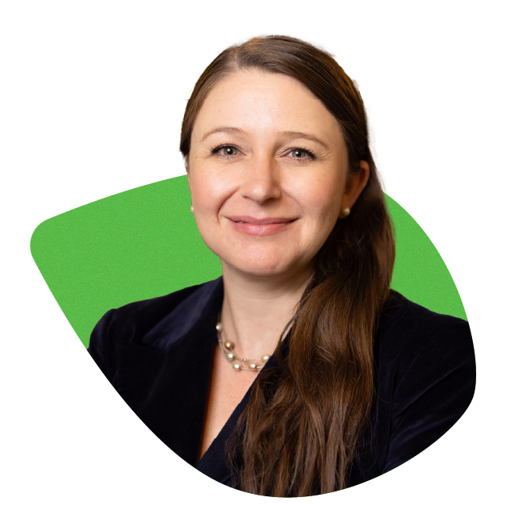
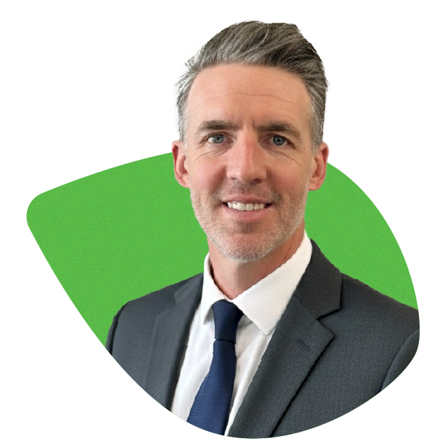
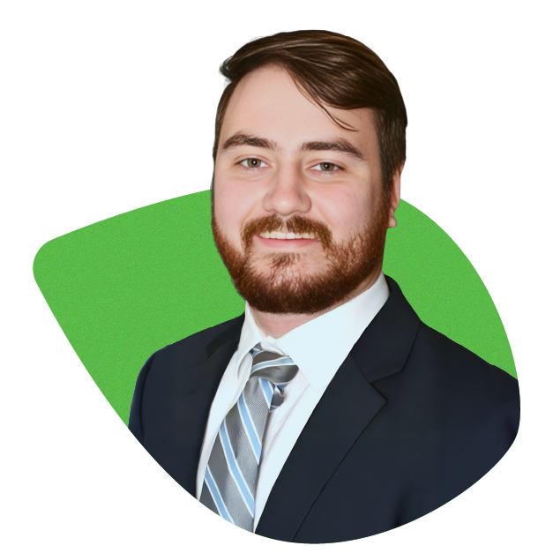
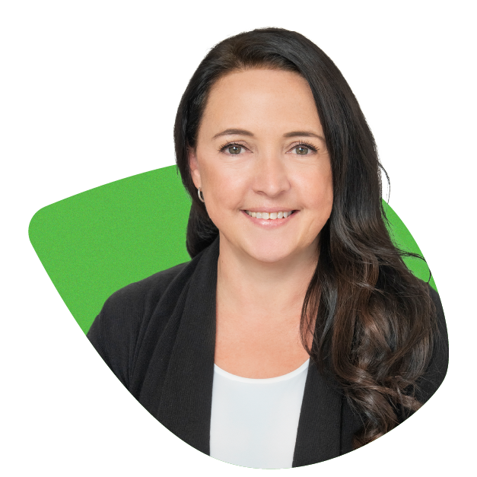
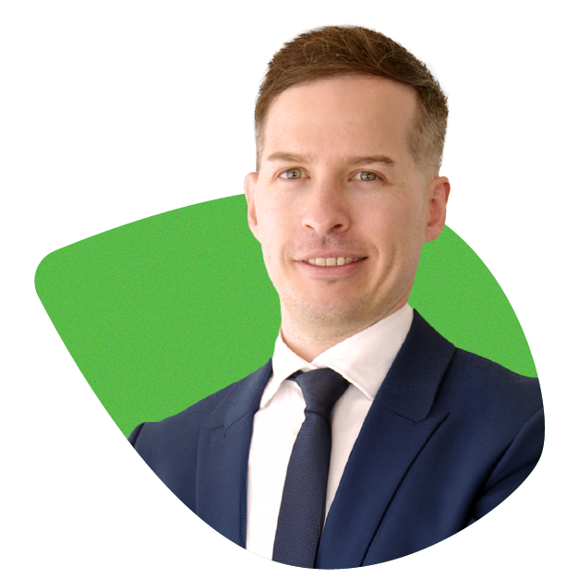
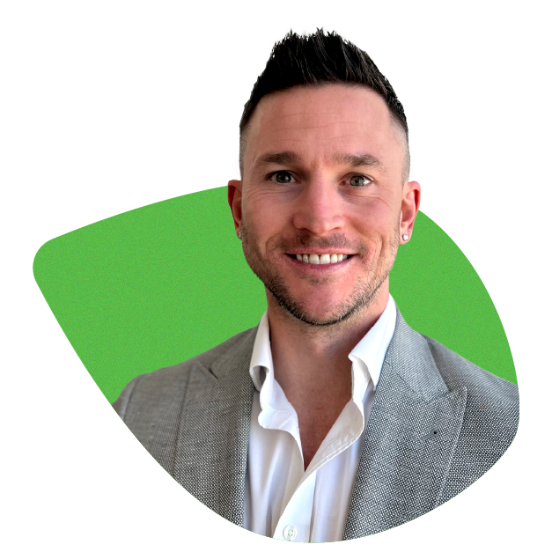
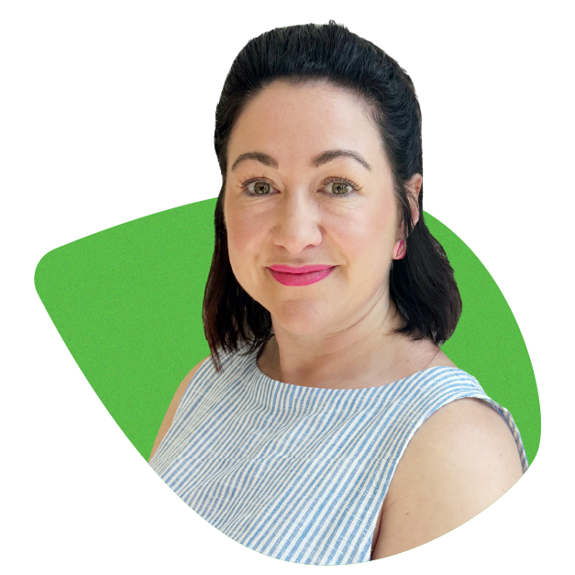
YOUR BRIGTHQ SALES TEAM
Chris Meaker
Head of Distribution
E: chris.meaker@brighten.com.au
NSW
QLD
COMMERCIAL
REVERSE MORTGAGES
Prashanth Ratnabala
Senior BDM (NSW)
T: 0459 820 882
E: prashanth.ratnabala@brighten.com.au
Nicola Schuback
Senior BDM (QLD)
T: 0400 931 616
E: nicola.schuback@brighten.com.au
Ben Mckell
Head of Commercial Lending
T: 0467 801 221
E: ben.mckell@brighten.com.au
Sharon Yardley
Head of Reverse Mortgages
T: 0422 474 009
E: sharon.yardley@brighten.com.au
VIC / TAS
WA / NT
Daryl Corletto
Commercial BDM (VIC)
T: 0413 419 797
E: daryl.corletto@brighten.com.au
Nick Taylor
Reverse Mortgages Manager
T: 0494 652 270
E: nicholas.taylor@brighten.com.au
Nicole Woodruff
State Manager (VIC/TAS)
T: 0417 504 219
E: nicole.woodruff@brighten.com.au
Scott Chandler
State Manager (WA/SA/NT)
T: 0466 727 877
E: scott.chandler@brighten.com.au
Jay Allen
Senior BDM (VIC) |
National Aggregation Manager
T: 0426 398 073
E: jay.allen@brighten.com.au
SA
Rochelle Melino
Senior BDM (SA)
T: 0413 536 142
E: rochelle.melino@brighten.com.au
1

Slide 2
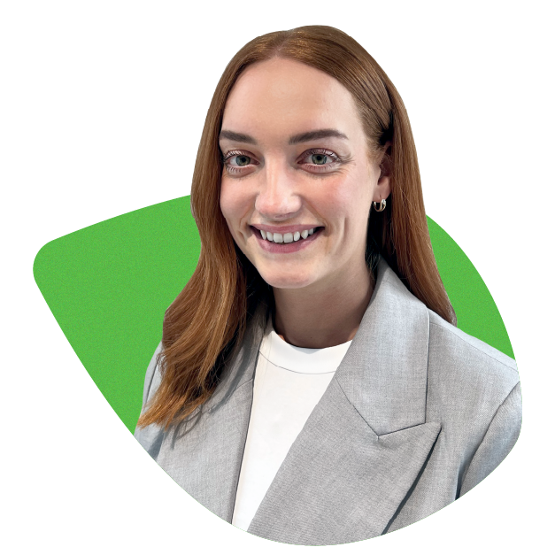
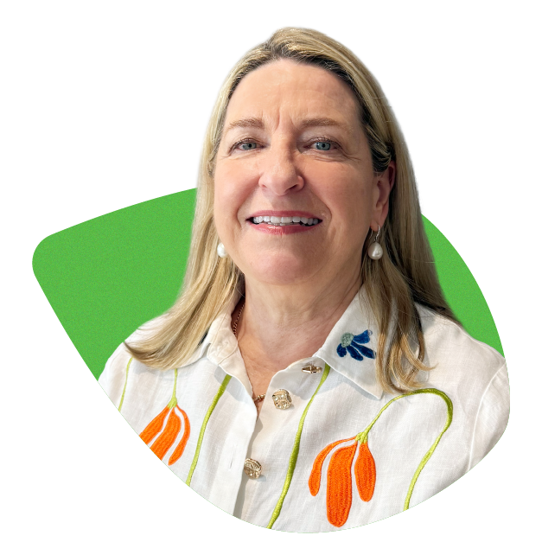

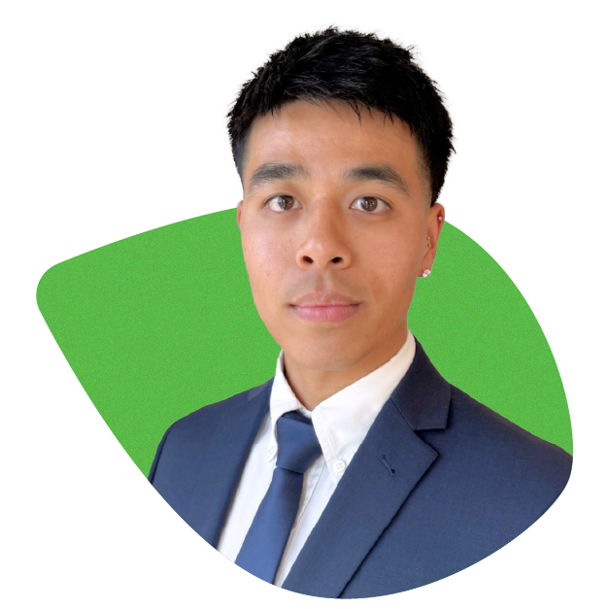
YOUR RELATIONSHIP MANAGEMENT TEAM
Our Relationship Management team are an extension of our frontline support for brokers. They’re here to help whenever a BDM isn’t immediately available, providing prompt assistance across a wide range of needs. From workshopping scenarios and guiding you through AOL and online submissions, to helping progress applications and keeping files moving smoothly toward settlement, they ensure you always have a knowledgeable and responsive point of contact. They play a vital role in delivering the seamless, broker-first experience we’re known for.
Hannah McNeill
Relationship Manager
Susan Sampson
Relationship Manager
Serina Ma
Relationship Manager
Thomas Do
Relationship Manager
For support, please contact our Relationship Management team at rmteam@brighten.com.au
2

Slide 3
CONTACT LIST
Scenario Enquiries | rmteam@brighten.com.au
Application Submissions | application@brighten.com.au
Escalations | lending.escalations@brighten.com.au
Contact Us
Settlements | settlement@brighten.com.au
Variations / Post Settlement | clientservices@brighten.com.au
Call Brighten on 13 14 88 at any stage of your application process for assistance.

